Slide 1
Mixed effects Modelling 2 – fitting
Starting point:
Clarity about what is your response variable and what are explanatory variables – which are fixed and which random
Scientific questions about the relationship between response and explanatory variables
Data in a long-form dataframe or tibble
Data in a long-form dataframe or tibble

Slide 2
Example Experiment – variables
Growth of orange trees
Three variables:
Circumference (numeric, continuous)
Age (numeric, continuous, fixed)
Tree (numeric, categorical, random)
Roles in experiment
Response variable
What we care about
What we measured
Want to know if it responds to explanatory variables
Not set as part of experiment
Biological and technical ‘noise’ in the measurement
Explanatory variable – fixed
Something we can manipulate
What we manipulated
Want to know if it affects the response variable
Set precisely as part of the experiment
Little or no ‘noise’ in the value
Explanatory variable – random
Something we have done or picked or sampled
What we sampled from
Want to know how it affects the response variable
Set as part of the experiment
No ‘noise’ in the value
Clarity about what is your response variable and what are explanatory variables – which are fixed and which random

Slide 3
Example Experiment – variables
Growth of orange trees
Three variables:
Circumference (numeric, continuous)
Age (numeric, continuous, fixed)
Tree (numeric, categorical, random)
Have a nice fit for an individual tree
Want to fit a random effect at the same time to capture the variation among individual trees
lm(log(circumference) ~ age + I(age^2))
library(lme4)
lmer(log(circumference) ~ age + I(age^2) + (1|Tree))
Various packages fit mixed effects models, espcially nlme and brms

Slide 4
Example Experiment – variables
Growth of orange trees
Three variables:
Circumference (numeric, continuous)
Age (numeric, continuous, fixed)
Tree (numeric, categorical, random)
Have a nice fit for an individual tree
Want to fit a random effect at the same time to capture the variation among individual trees
lm(log(circumference) ~ age + I(age^2))
library(lme4)
lmer(log(circumference) ~ age + I(age^2) + (1|Tree))
Various packages fit mixed effects models, espcially nlme and brms

Slide 5
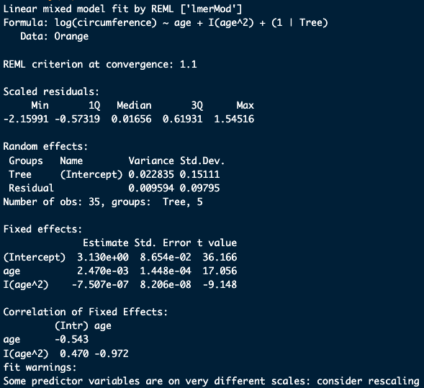
Example Experiment – variables
Growth of orange trees
Three variables:
Circumference (numeric, continuous)
Age (numeric, continuous, fixed)
Tree (numeric, categorical, random)
> summary(model)

Slide 6
Example Experiment – questions
Growth of orange trees
Three variables:
Circumference (numeric, continuous)
Age (numeric, continuous, fixed)
Tree (numeric, categorical, random)
> summary(model)
How much does circumference vary among trees?
Pick either the Variance or SD to report (one is the square of the other)
Often SD, because it’s on the same scale as the response variable
Here the response variable is on a log scale, so 0.15 not so helpful
Variances can be better because they add up
Proportion of variance that’s among trees = Variance among trees/(Variance among trees + residual variance) =
0.023/(0.023 + 0.096) = 0.70
i.e. 70% of the variation we see from the growth curve is variation among trees

