Slide 1
Mixed effects Modelling 1 – getting started
Starting point:
Clarity about what is your response variable and what are explanatory variables – which are fixed and which random
Scientific questions about the relationship between response and explanatory variables
Data in a long-form dataframe or tibble
Data in a long-form dataframe or tibble

Slide 2
Example Experiment – variables
Growth of orange trees
Three variables:
Circumference (numeric, continuous)
Age (numeric, continuous, fixed)
Tree (numeric, categorical, random)
Roles in experiment
Response variable
What we care about
What we measured
Want to know if it responds to explanatory variables
Not set as part of experiment
Biological and technical ‘noise’ in the measurement
Explanatory variable – fixed
Something we can manipulate
What we manipulated
Want to know if it affects the response variable
Set precisely as part of the experiment
Little or no ‘noise’ in the value
Explanatory variable – random
Something we have done or picked or sampled
What we sampled from
Want to know how it affects the response variable
Set as part of the experiment
No ‘noise’ in the value
Clarity about what is your response variable and what are explanatory variables – which are fixed and which random

Slide 3
Example Experiment – questions
Growth of orange trees
Three variables:
Circumference (numeric, continuous)
Age (numeric, continuous, fixed)
Tree (numeric, categorical, random)
Questions
How do orange trees grow?
A bit too vague
Scientific questions about the relationship between response and explanatory variables
Clarity about what is your response variable and what are explanatory variables – which are fixed and which random

Slide 4
Example Experiment – data
Growth of orange trees
Three variables:
Circumference (numeric, continuous)
Age (numeric, continuous, fixed)
Tree (numeric, categorical, random)
Questions
How do orange trees grow?
A bit too vague
Data looks a bit problematic
Doesn’t seem very linear
Really bunched at low levels and spread out at high ones
Don’t start reading up on non-linear modelling just yet
‘Heteroscedasticity’ – a problem
Try looking at the data on a logarithmic scale
Can be appropriate for growth
If grows a certain % per time, rather than a certain distance
Body size is never negative
Can sort out non-normality as well as heteroscedasticity
Often try to be more precise when measuring small things
A log scale is a whole lot better (though heteroscedasticity not completely sorted)
Scientific questions about the relationship between response and explanatory variables
Clarity about what is your response variable and what are explanatory variables – which are fixed and which random

Slide 5
Example Experiment – subset
Three variables:
Circumference (numeric, continuous)
Age (numeric, continuous, fixed)
Tree (numeric, categorical, random)
Questions
How do orange trees grow?
A bit too vague
Data still looks curvy
Try fitting a quadratic curve – ask does logarithmic growth slow with age?
Start with one level of the random effect
> model <- lm(log(circumference) ~ age + I(age^2), data = Orange3)
> summary(model)
Scientific questions about the relationship between response and explanatory variables
Clarity about what is your response variable and what are explanatory variables – which are fixed and which random

Slide 6
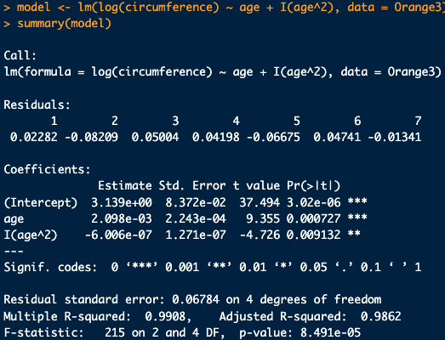
Example Experiment – subset
Growth of orange trees
Fits nicely
Good if just want parameters or hypothesis tests
Does logarithmic growth slow with age?
Yes, logarithmic growth slows with age P = 0.009
Bad if want to extrapolate

